Slide 1

Motion Control：Lecture 4.3
Least Squares Curve Approximation
Jiangang Li
Nov 14 2016

Slide 2
Globe( It is smooth)
Up Limited
Real tool path express by lines
Ideal tool path
Down Limited
PCS Interpolating
b) Local
Fig.1 Tool Path in Globe and Local

Slide 3









Given the following parameters, a B-Spline Curve can be determined uniquely.
Parameter Name
symbols
Remarks
Degree
The number of control point
The number of knot vector
The control points
Knot vector

Slide 4


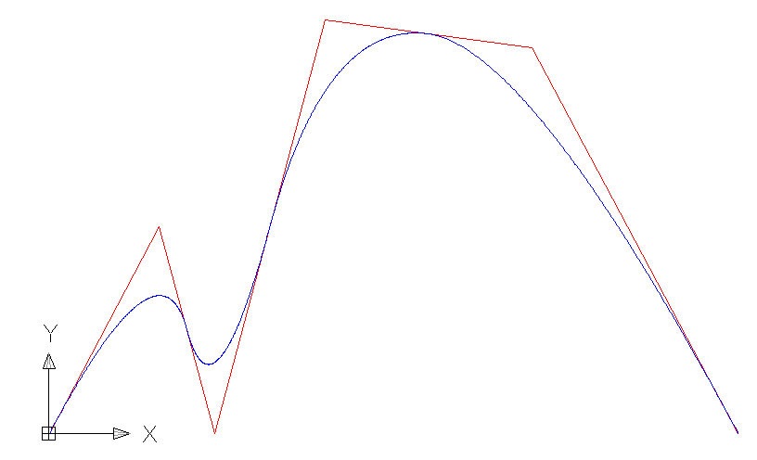








2 B-Spline Fitting of CL Path

Slide 5







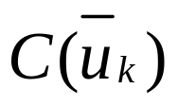





Slide 6






2 B-Spline Fitting of CL Path
Known Parameters
Degree
The number of control point
The number of knot vector
The minimal number of points need be fitted
The number of points need be fitted
The points need be fitted
Parameters obtained after LSCA
The control points
Knot vector

Slide 7




The principle of LSCA

Slide 8





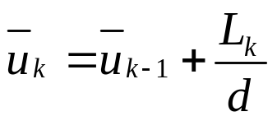




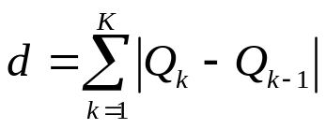

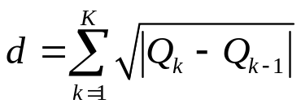
1 Giving
，
，
2 Choosing the
，
，
Where
Chord Length Method:
，
Centripetal Method:
，

Slide 9






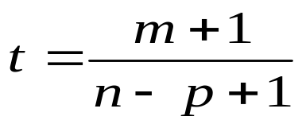


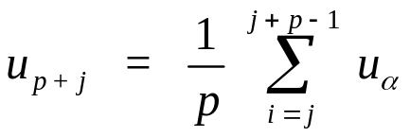
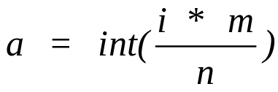
2 B-Spline Fitting of CL Path
3 Choosing the knot value
The First Kind Method--Averaging
Where
，
，
The Second Kind Method----Optimizing
Where

Slide 10

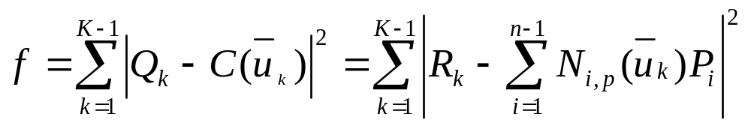


4 Least Squares Sense
Where,

Slide 11




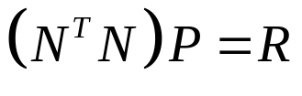


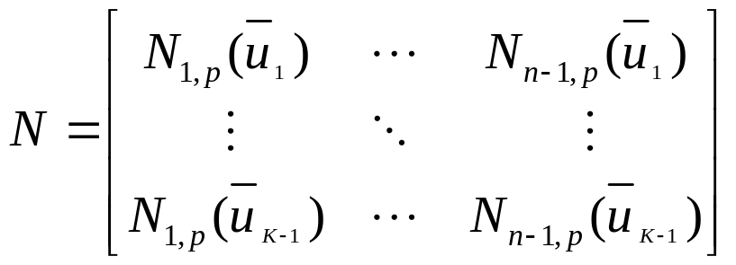
5 To minimize we set the derivatives of with respect to the points ,
( ) equal to zero.
After simplification, the linear equations about are
Where is the matrix of scalars

Slide 12


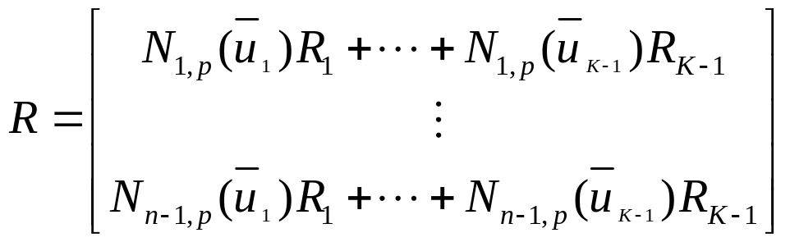
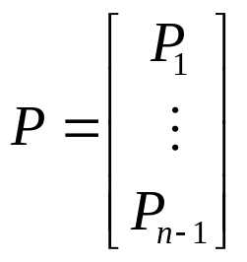
is the vector of points
and

Slide 13

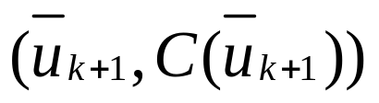
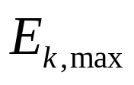
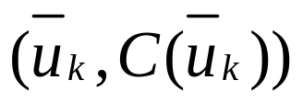
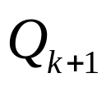
According to LSCA method, we can get a piece of B-Spline curve. But we must check the maximal chord error between the B-Spline curve and the CL path.
B-Spline Curve
CL Path

Slide 14
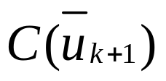
approximate
B-Spline
CL Path

Slide 15
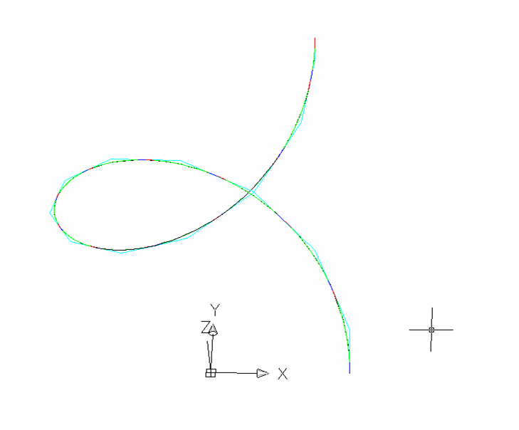
A Example of Spiral line

Slide 16
What could we do when fitting error is out constraint?
Increase the control points number;
Decrease the fitting points number;
Some adaptive method for knot vector selection;
……..
But, the best results are obtained with new files made with the right CAM process in mind.
You can use fitting method with old files but the results may not be as optimal.

